Slide 1
Preprocessing
- data cleaning (basic done)
- train/test data

Slide 2
Train and Test datasets in Machine Learning
Machine Learning is one of the booming technologies across the world that enables computers/machines to turn a huge amount of data into predictions. However, these predictions highly depend on the quality of the data, and if one is not using the right data for their model, then it will not generate the expected result.
In machine learning projects, generally divide the original dataset into training data and test data. One will train their model over a subset of the original dataset, i.e., the training dataset, and then evaluate whether it can generalize well to the new or unseen dataset or test set.
Therefore, train and test datasets are the two key concepts of machine learning, where the training dataset is used to fit the model, and the test dataset is used to evaluate the model.

Slide 3
Training data
Training data is used to train the machine learning model. Training data is the power that supplies the model in machine learning, it is larger than testing data. Because more data helps to more effective predictive models.
When a machine learning algorithm receives data from the records, it recognizes patterns and creates a decision-making model.
Algorithms allow a company’s past experience to be used to make decisions. It analyzes all previous cases and their results and, using this data creates models to score and predict the outcome of current cases. The more data ML models have access to, the more reliable their predictions get over time.

Slide 4

Training data consists of input-output pairs, where the input, known as “features” or “predictors”, is matched with an output referred to as a “label” or “target.”
These datasets contain various types of information – from images and text to numerical values and sensor readings.
For instance, in image classification, training data contains images paired with labels that describe objects or scenes depicted in the pictures.

Slide 5
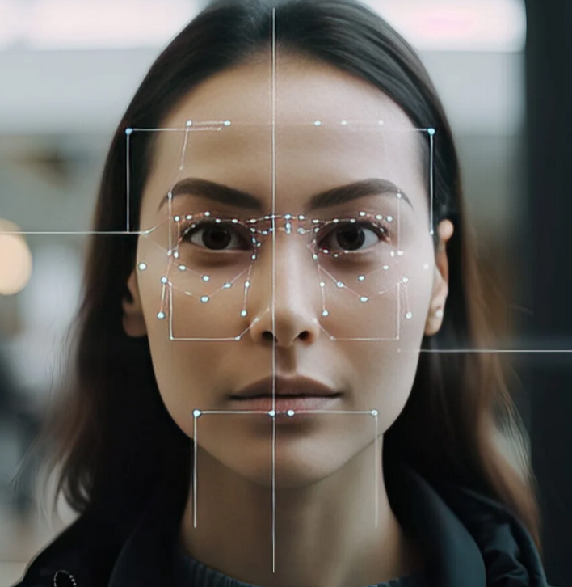
How is training data employed to teach ML and AI models?
Machine learning algorithms use training data to learn to analyze patterns within the datasets and improve their understanding of real-world situations. Throughout this process, the algorithm adjusts its parameters to minimize the gap between its predictions and the actual labels in the training data.
This continuous process enhances the model’s accuracy in making predictions. As the algorithm dives deeper into the dataset’s specifics, it gradually builds a representation of the underlying patterns. The purpose of training is to equip the system with the ability to apply its knowledge to new data, allowing it to predict or classify instances it hasn’t encountered before.

Slide 6
In essence, training data shapes algorithms by providing them with knowledge and insights needed to handle complexities in real-world data.
Without an accurate and representative training dataset, machine learning models may be susceptible to biases and oversights that could restrict their capacity to generalize to unfamiliar examples.

Slide 7
Types of Training Data
Training data comes in different forms – each has its own distinctive characteristics and applications.
Let’s explore the three main training data types:
- structured,
- unstructured, and
- semi-structured.

Slide 8
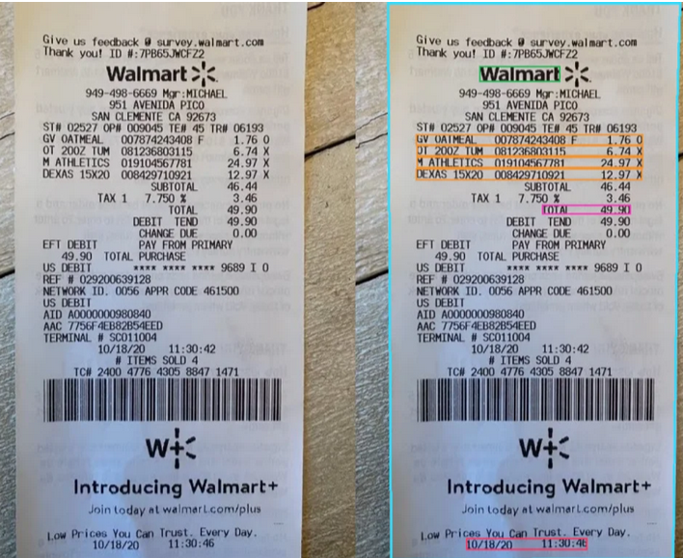
Structured data
Structured data is typically arranged in a specific format – usually in columns and rows – to aid ML learning models in data processing and analysis. This type of training data adheres to a defined structure outlined by a schema, making it easy for machines to organize and analyze data.
Some basic examples of structured data include databases, spreadsheets, and tables.
Imagine an Excel spreadsheet with rows and columns filled with numbers or a database that stores customer information neatly categorized by name, address, and phone number – that’s structured training data.

Slide 9
Sources
Common sources of structured datasets include databases, customer relationship management (CRM) systems, and financial records. These sources provide data for training machine learning models in tasks such as predictive analytics, customer segmentation, and fraud detection.
Other sources of this data are APIs, Web Services (like JSON or XML), and Internet of Things (IoT) Devices that generate data in specific formats suitable for analysis across various fields (smart homes, healthcare, and industrial automation).
Applications
In finance, structured data is used in analyzing stock market trends and forecasting market changes.
In the field of healthcare, electronic health records (EHRs) provide data that can assist in decision-making and patient diagnoses.
By incorporating microdata tags within the HTML code of a webpage, search engines receive detailed information to enhance the site’s SEO features (????).

Slide 10
Unstructured data
Unstructured data refers to information that lacks a predefined format or organization.
Unlike structured data, which is typically stored in databases with a specific schema, unstructured data doesn’t follow a fixed structure.
It includes various types of content – text, images, videos, audio recordings, social media posts, and more.
Since unstructured data is often qualitative in nature, it may not neatly (precisely) fit into rows and columns like structured data does.
Examples of unstructured data can include text documents, customer reviews, sensor readings, and multimedia files.

Slide 11
Semi-structured data
Semi-structured data falls between the two previous data types and offers a mix of organization and flexibility.
This type of training data possesses a defined structure but still allows for some degree of variation in format.
Sources of semi-structured training material include web applications with user interactions, API responses, and log files.
Since semi-structured data is a combination of the two data types mentioned above, its key sources also encompass Internet of Things Devices and social media platforms.
Semi-structured data can also be found in legal documents and surveys.

Slide 12
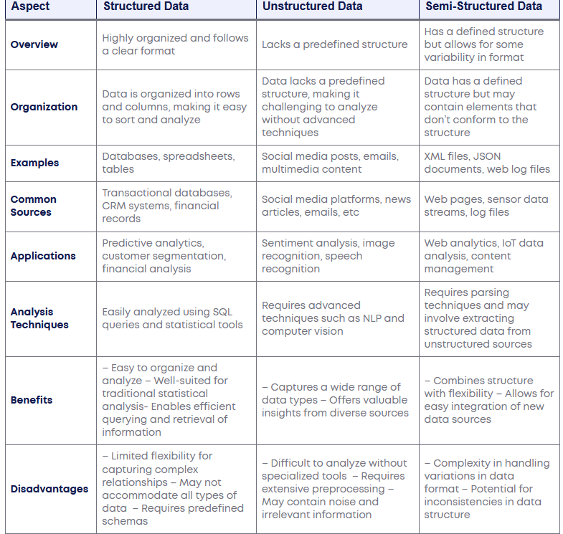

Slide 13
How do training and testing data work in Machine Learning?
Machine Learning algorithms enable the machines to make predictions and solve problems on the basis of past observations or experiences.
These experiences or observations an algorithm can take from the training data, which is fed to it.
Further, one of the great things about ML algorithms is that they can learn and improve over time on their own, as they are trained with the relevant training data.

Slide 14
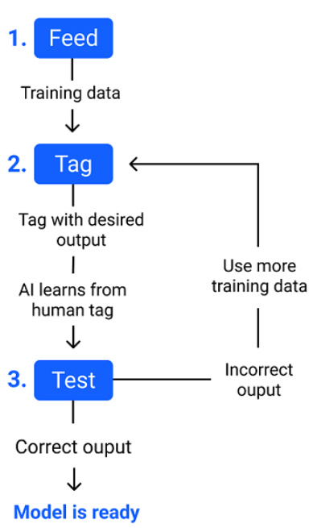
Once the model is trained enough with the relevant training data, it is tested with the test data.
Once can understand the whole process of training and testing in three steps, which are as follows:
Feed: Firstly, one needs to train the model by feeding it with training input data.
Define: Now, training data is tagged with the corresponding outputs (in Supervised Learning), and the model transforms the training data into text vectors or a number of data features.
Test: In the last step, one tests the model by feeding it with the test data/unseen dataset. This step ensures that the model is trained efficiently and can generalize well.

Slide 15

Challenges in Creating Training Data
Data collection
The process of collecting data can be quite daunting. Here’re some of the most common challenges in data collection.
Difficulties in sourcing and collecting training data
Managing data quality
Raw data often contains errors and discrepancies despite efforts to maintain accuracy during collection. Data profiling is essential to identify issues, while data cleansing helps resolve them.
Finding relevant data
The process of gathering data itself presents a complex task for data scientists. Implementing data curation techniques such as creating a data catalog and searchable indexes can simplify data discovery and accessibility.
Dealing with Big Data
Managing volumes of unstructured and semi-structured data in Big Data environments adds complexity during collection and processing phases. Data scientists often need to navigate through data stored in a data lake (a centralized repository) to extract relevant information.

Slide 16
Data Annotation
Once data is collected, it needs to undergo annotation – it’s a process of labeling data with relevant tags to make it more comprehensive for computers. However, data annotation presents its own set of challenges.
Importance of Data Annotation
Training Machine Learning Models: Machine learning models require labelled data to learn and make accurate predictions.
Enhancing Data Understanding: Data annotation adds valuable context and meaning to raw data. By assigning labels or annotations, annotators provide information that helps algorithms understand the data better. For example, in image recognition, annotating objects within an image helps machines recognize and differentiate objects accurately.
Validating Model Performance: Data annotation is essential for evaluating and validating the performance of machine learning models.

Slide 17
Types of Data Annotation
Image Annotation: Image annotation involves labelling objects, regions, or features within an image. It can include bounding boxes, polygons, key point annotations, or semantic segmentation, enabling algorithms to recognize and classify objects accurately.
Text Annotation: Text annotation focuses on labelling or tagging textual data. It can involve tasks such as named entity recognition, sentiment analysis, part-of-speech tagging, or text classification.
Audio Annotation: Audio annotation involves labelling and transcribing audio data. It can include tasks such as speech recognition, speaker identification, or emotion detection.
Video Annotation: Video annotation involves labelling objects, actions, or events within a video sequence. It can include tasks such as activity recognition, object tracking, or event detection.

Slide 18
Data Annotation Example: Image Classification for Autonomous Vehicles
One prominent example of data annotation is image classification for autonomous vehicles. Autonomous vehicles rely on advanced computer vision systems to detect and recognize objects in their surroundings, enabling them to navigate safely and make informed decisions.
Dataset Collection
To begin the data annotation process, a vast dataset of images is collected, which typically includes various types of objects, such as pedestrians, vehicles, traffic signs, and road markings.
Annotation Guidelines
Before the annotation process begins, annotation guidelines are established. These guidelines define the specific labels or tags to be assigned to different objects within the images. For instance, the guidelines might include labels such as “car,” “pedestrian,” “bicycle,” “stop sign,” and “traffic light.”
Annotators’ Role
Highly skilled and trained annotators play a critical role in the data annotation process.

Slide 19
Annotation Challenges for the previous example.
Data annotation for autonomous vehicles presents unique challenges.
For instance:
Object Variations: Objects in real-world images can vary in terms of size, shape, orientation, and occlusion. Annotators must accurately identify and label these objects, even when partially visible or occluded by other objects.
Ambiguity: Some images may contain objects that are challenging to label definitively. Annotators must rely on their expertise and judgment to assign the most appropriate label based on the available information.
Edge Cases: Autonomous vehicles encounter rare and unusual scenarios on the road. Annotators must anticipate these edge cases and create annotations that cover a wide range of scenarios to ensure the models’ robustness and generalization.

Slide 20
Why is it important to use separate
training and testing data?

Slide 21
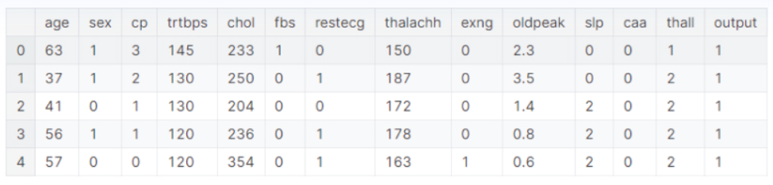
Consider the above numerical dataset, which represents the task of heart attack prediction. As one can see, 13 attributes represent a patient’s details and level of health.
The last attribute, the output, has a binary class(0 or 1) representing whether a heart attack is possible.
ML models learn from these 13 attributes and develop a pattern that outputs the respective binary value.

Slide 23
What is Test Dataset?
Once we train the model with the training dataset, it's time to test the model with the test dataset. This dataset evaluates the performance of the model and ensures that the model can generalize well with the new or unseen dataset. The test dataset is another subset of original data, which is independent of the training dataset.
However, it has some similar types of features and class probability distribution and uses it as a benchmark for model evaluation once the model training is completed.
Test data is a well-organized dataset that contains data for each type of scenario for a given problem that the model would be facing when used in the real world.
Usually, the test dataset is approximately 20-25% of the total original data for an ML project.

Slide 24
The testing data should:
→ Represent or part of the original dataset.
→It should be large enough to give meaningful predictions.

Slide 25
Overfitting and Underfitting issues
Overfitting and underfitting are the most common problems that occur in the Machine Learning model.
A model can be said as overfitted when it performs quite well with the training dataset but does not generalize well with the new or unseen dataset.
The issue of overfitting occurs when the model tries to cover all the data points and hence starts caching noises present in the data. Due to this, it can't generalize well to the new dataset. Because of these issues, the accuracy and efficiency of the model degrade.
Generally, the complex model has a high chance of overfitting. There are various ways by which we can avoid overfitting in the model, such as Using the Cross-Validation method, early stopping the training, or by regularization, etc.

Slide 26
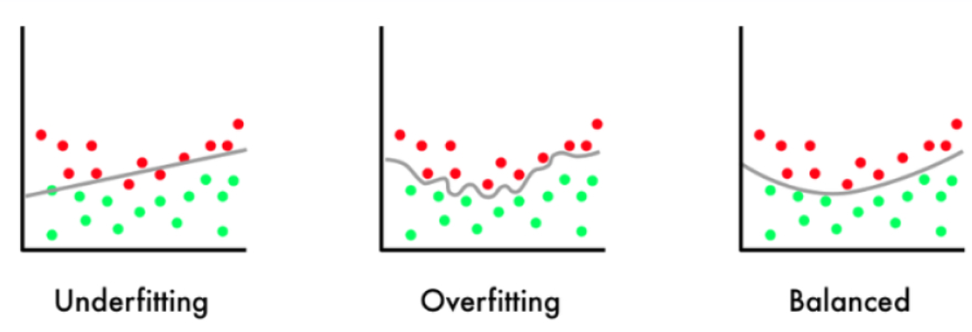
Examples to identify overfitting & underfitting
Example 1:
Suppose we observe the model performance on the training and testing data
- Training Accuracy: 97% and Testing Accuracy: 68%
As one can see, the training accuracy is very high, while the testing accuracy shows poor performance. In this scenario, the model most likely overfits the data.
Example 2:
- Training Accuracy: 60% and Testing Accuracy: 55%
Here, one can see that the training accuracy is very low, and the testing accuracy also shows poor performance. In this scenario, the model most likely underfits the data.

